Slide 1
Impact of Cars Features on Price and Profitability
By
Moksh Jaiswal

Slide 2
Table of contents
01
02
03
04
05
06
Description
Approach
Tech Stacks Used
Data Preparation
Analysis
Key Insights

Slide 3
01
Description

Slide 4
Before we begin…
How can a car manufacturer optimize pricing and product development decisions to maximize profitability while meeting consumer demand?
By using data analysis techniques such as regression analysis and market segmentation, the manufacturer could develop a pricing strategy that balances consumer demand with profitability, and identify which product features to focus on in future product development efforts.
A data analyst could use this dataset to gain insights into various aspects of the automotive industry, such as:
Analyzing trends in car features and pricing over time.
Comparing the fuel efficiency of different types of cars.
Investigating the relationship between a car's features and its popularity.
Predicting the price of a car based on its features and market category.

Slide 5
02
Approach

Slide 6
Step 1
Step 4
Understanding the data
Visualising the data
Step 2
Step 3
Cleaning the data
Analysing the data

Slide 7
03
Tech Stacks Used

Slide 8

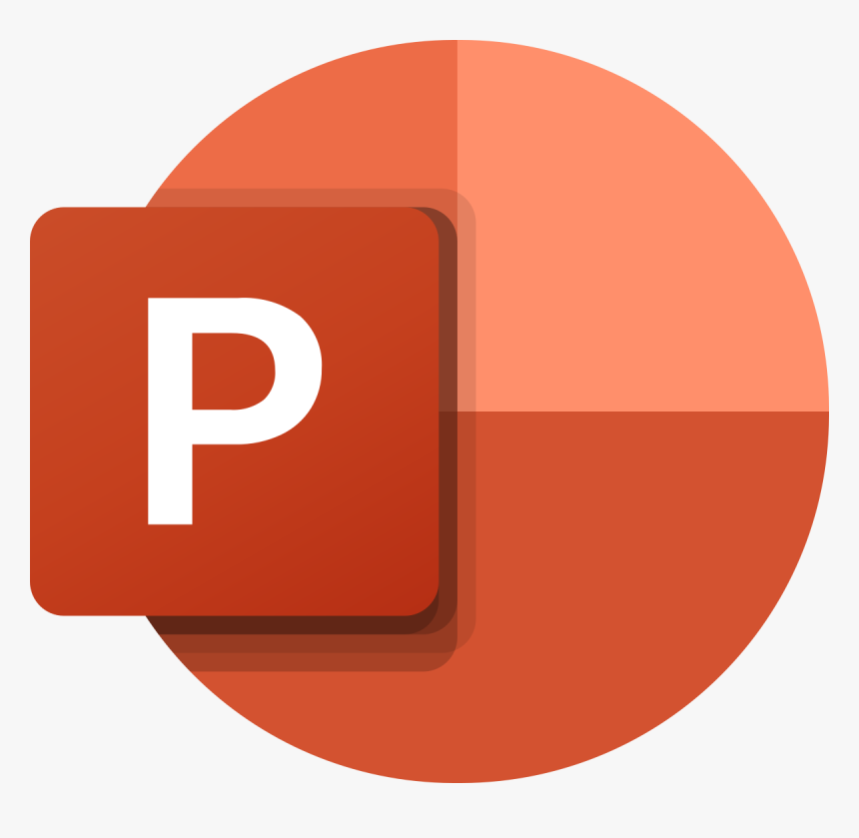
Microsoft Excel 2019
Microsoft Powerpoint 2019
Data Cleaning
Data Analysis
Data Visualisation
Dashboard
Presentation

Slide 9
04
Data Preparation

Slide 10
Understanding the Data
Rows
16
Rows
16
11,914
Columns
11,914
Columns
Duplicates
48
Car Manufacturers
715
Duplicates
715

Slide 11
Null and Unknown Values
Market category
Transmission Type

Slide 12
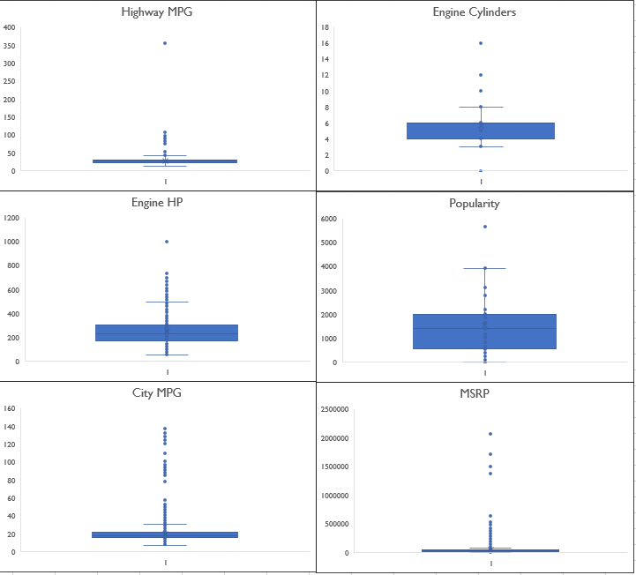
Outliers
Engine Cylinders
Removing outliers will remove all the electric vehicles.
Highway/City MPG
Extreme value of 354 which is practically impossible.
MSRP
Didn’t remove the outliers as it would remove all the luxury car brands.

Slide 13
Data Cleaning
Engine Fuel Type
premium unleaded(required) | Premium Unleaded
premium unleaded(recommended) | Premium Unleaded
regular unleaded | Regular Unleaded
flex-fuel(unleaded/E85) | Flex–Fuel E85
flex-fuel(premium unleaded required/E85) | Flex–Fuel
flex-fuel(premium unleaded recommended/E85) | Flex–Fuel
Flex-fuel(unleaded/natural gas) | Flex–Fuel Natural Gas

Slide 14
Data Cleaning
Engine HP: 69 nulls
Make | Model | Engine HP
Lincoln | Continental | 305
FIAT | 500e | 111
Ford | Escape | 175
Honda | Fit EV | 123
Ford | Focus | 143
Ford | Freestar | 201
Mitsubishi | i-MiEV | 66
Chevrolet | Impala | 260
Nissan | Leaf | 107
Mercedes-Benz | M-Class | 200
Lincoln | MKZ | 188
Tesla | Model S | 362 / 382
Toyota | RAV4 EV | 154
Kia | Soul EV | 109

Slide 15
Data Cleaning
Engine Cylinders: 30 Nulls
Make | Model | Engine Cylinders | Engine Fuel Type | Cylinder Type
Chevrolet | Bolt EV | 0 | electric | electric
Volkswagen | e-Golf | 0 | electric | electric
Mitsubishi | i-MiEV | 0 | electric | electric
Toyota | RAV4 EV | 0 | electric | electric
Mazda | RX-7 | 0 | Regular Unleaded | rotary/Wankel
Mazda | RX-8 | 0 | Premium Unleaded | rotary/Wankel

Slide 16
Data Cleaning
Number of Doors: 6 nulls
Transmission Type
Make | Model | Number of doors
Ferrari | FF | 4
Tesla | Model S | 4
Transmission Type | Imputation
UNKNOWN | AUTOMATIC
We have used Mode to impute the UNKOWN value.
No changes were made to the N/A in Market Category.
All the duplicate rows (715) were deleted.

Slide 17
05
Data Analysis

Slide 18
What are the most popular market categories ?
Crossover is the highest selling car and also one of the most popular ones along with Flex-Fuel, Diesel, Hatchback and Performance with a average popularity score of 5657.

Slide 19
Is there a relaionship between Engine Power and Price ?
Engine Power and Price(MSRP) are moderately positively correlated.
Bugatti Veyron 16.4 has the prominent price range between $1M – $3M along with offering the highest engine power of 1001 HP.
Correlation = 0.6586

Slide 20
Which are the most crucial features that affects the car price ?
The horsepower and the Cylinders in Engine contributes the most in determining the car price.
Meanwhile, the vehicle style and it’s size have the least effect on the car’s price.

Slide 21
How does the average car price vary across different manufacturers ?
Exotic, Luxury and High-Performance/Performance cars are the most expensive cars.
Whereas, the mundane/Everyday use car brands like Oldsmobile, Pontiac and Mazda are the cheapest.

Slide 22
Does the number of cylinders in the car’s engine influences the fuel efficiency ?
Both the factors suggests a moderately negative correlation with the fuel efficiency.
As the number of cylinders increases the efficiency decreases.
-0.6103
-0.5853

Slide 23
06
Key Insights

Slide 24

The cars with horsepower ranging between 155 – 354 were the most purchased cars.
Most of the people prefer to purchase a car with automatic transmission.
As the horespower increases so does the price of the car.
Exotic and luxury cars does not loose their value over the course of time.
The fuel efficiency and the number of cylinders are inversely correlated. As the number of cylinders increases the efficiency of fuel decreases.

Slide 25
Thanks!
Do you have any questions?
moksh.jaiswal2004@gmail.com
https://www.linkedin.com/in/moksh-jaiswal-86199b231
https://github.com/MokshJaiswal
Presentation and all the other files
https://drive.google.com/drive/folders/10ktW3tOwUb-705u79YhqPzSMJhEa7y7e?usp=sharing

